Slide 1
Chapter 21
Trivial File
Transfer Protocol
(TFTP)

Slide 2
CONTENTS
MESSAGES
CONNECTION
DATA TRANSFER
UDP PORTS
TFTP EXAMPLE
TFTP OPTIONS
SECURITY
APPLICATIONS

Slide 3

TFTP uses the services of UDP
on the well-known port 69.

Slide 4
21.1
MESSAGES

Slide 5
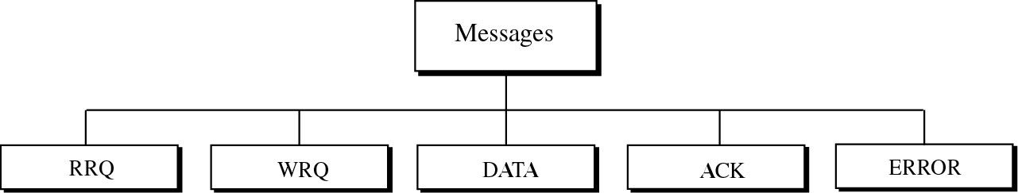
Figure 21-1
Message categories

Slide 6
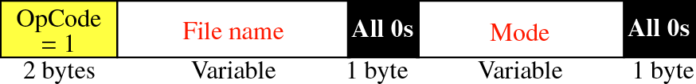
Figure 21-2
RRQ
Read request
Mode: netascii or octet

Slide 7
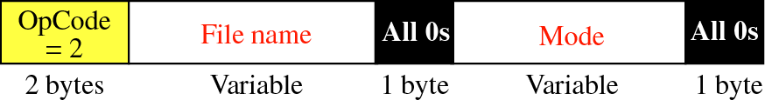
Figure 21-3
WRQ
Write request

Slide 8
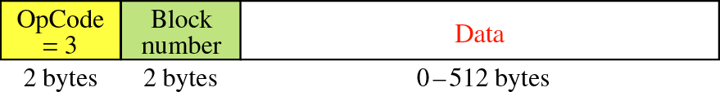
Figure 21-4
DATA format

Slide 9
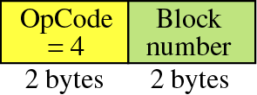
Figure 21-5
ACK format

Slide 10
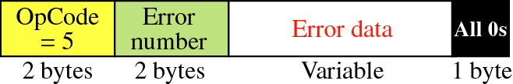
Figure 21-6
ERROR format

Slide 11
21.2
CONNECTION

Slide 12
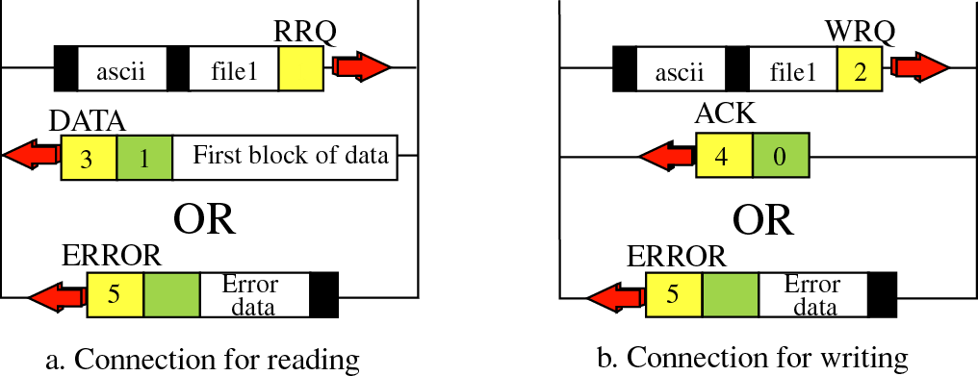
Figure 21-7
Connection establishment

Slide 13
21.3
DATA
TRANSFER

Slide 14
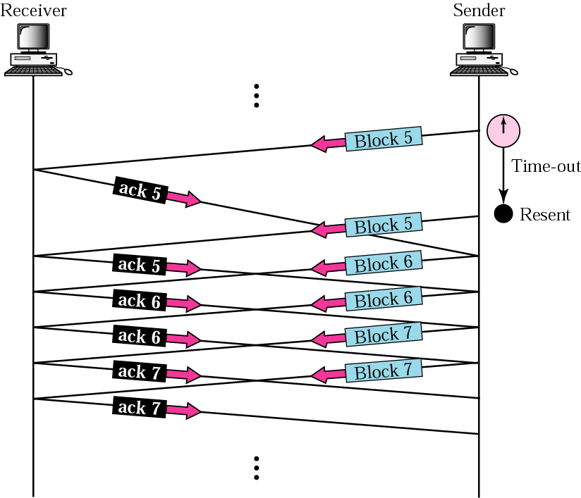
Figure 21-8
Sorcerer’s apprentice bug

Slide 15
21.4
UDP
PORTS

Slide 16
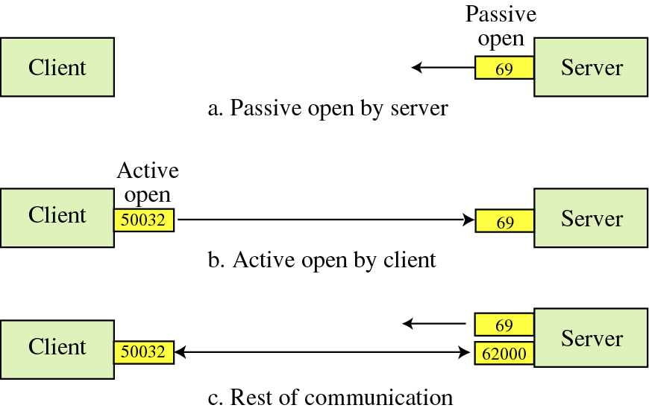
Figure 21-9
UDP port numbers used by TFTP

Slide 17
21.5
TFTP
EXAMPLE

Slide 18
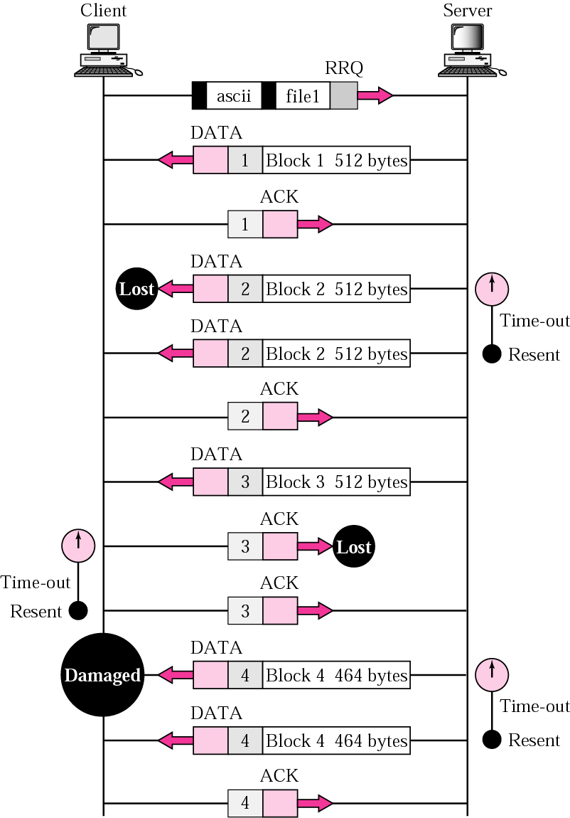
Figure 21-10
TFTP
example

Slide 19
21.6
TFTP
OPTIONS

Slide 20
21.7
SECURITY

Slide 21
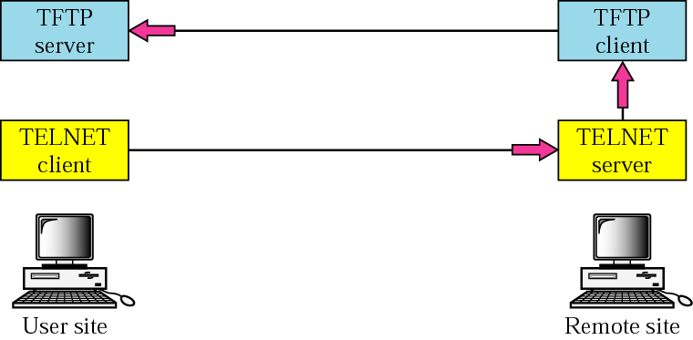
Figure 21-11
TELNET with FTP for security

Slide 22
21.8
APPLICATIONS

Slide 23
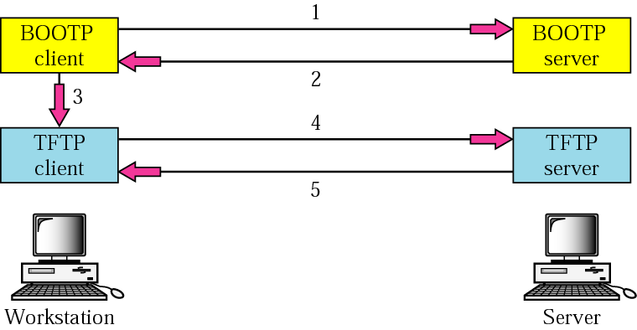
Figure 21-12
Use of TFTP with BOOTP

